Slide 1

Data Breaches
The Cost of Carelessness
Notes:
Good morning everyone
Happy to be able to present something that I find relevant to all our futures in data to a number of my peers whom I genuinely respect.
The title of my presentation is Data Breaches: The Cost of Carelessness

Slide 2

Tommy Ramey
Data Engineering
Data Analysis
ETL
Cyber Security
Cheese Lover
Contact:
Linkedin.com/tramey
Tramey1989@gmail.com
Notes:
Who am I and what am I about?
I have a curiosity about data, where it comes from, how it gets there and what keeps it safe.
I also enjoy cheese.

Slide 3

The Agenda
Introduction
Keywords
Overview
Analysis
Conclusion
Notes:
Heres what the agenda looks like for the presentation.
Sit back and enjoy my anxious fidgeting while I hopefully leave you with some valuable information for our futures in data.

Slide 4
Introduction
The Data
Notes:
Lets check out the data run down first.

Slide 5
Data Breach Investigations Report
Data Set¹ Scope
9,136 Incidents
9,054 Confirmed Breaches
2000 to 2022
Global
Analysis Scope
6,235 Incidents
6,188 Confirmed Breaches
2010 to 2022
United States
¹ Verizon 2022 Public DBIR Data:
https://www.verizon.com/business/resources/reports/dbir/#resources
Notes:
My data is from Verizons Data Breach Incident Report from 2022.

Slide 6

Keywords
Actor – Responsible Individual/Group
Internal - Employees
External – “The Bad Guys”
Vector – Attack Type i.e., Hacking, Misuse, Error, etc.
Variety – Specific classification of larger categories. i.e., Type of hack or malware used.
Notes:
Let’s do a brief terminology check before we move in so that when these terms appear you will have a better understanding.

Slide 7
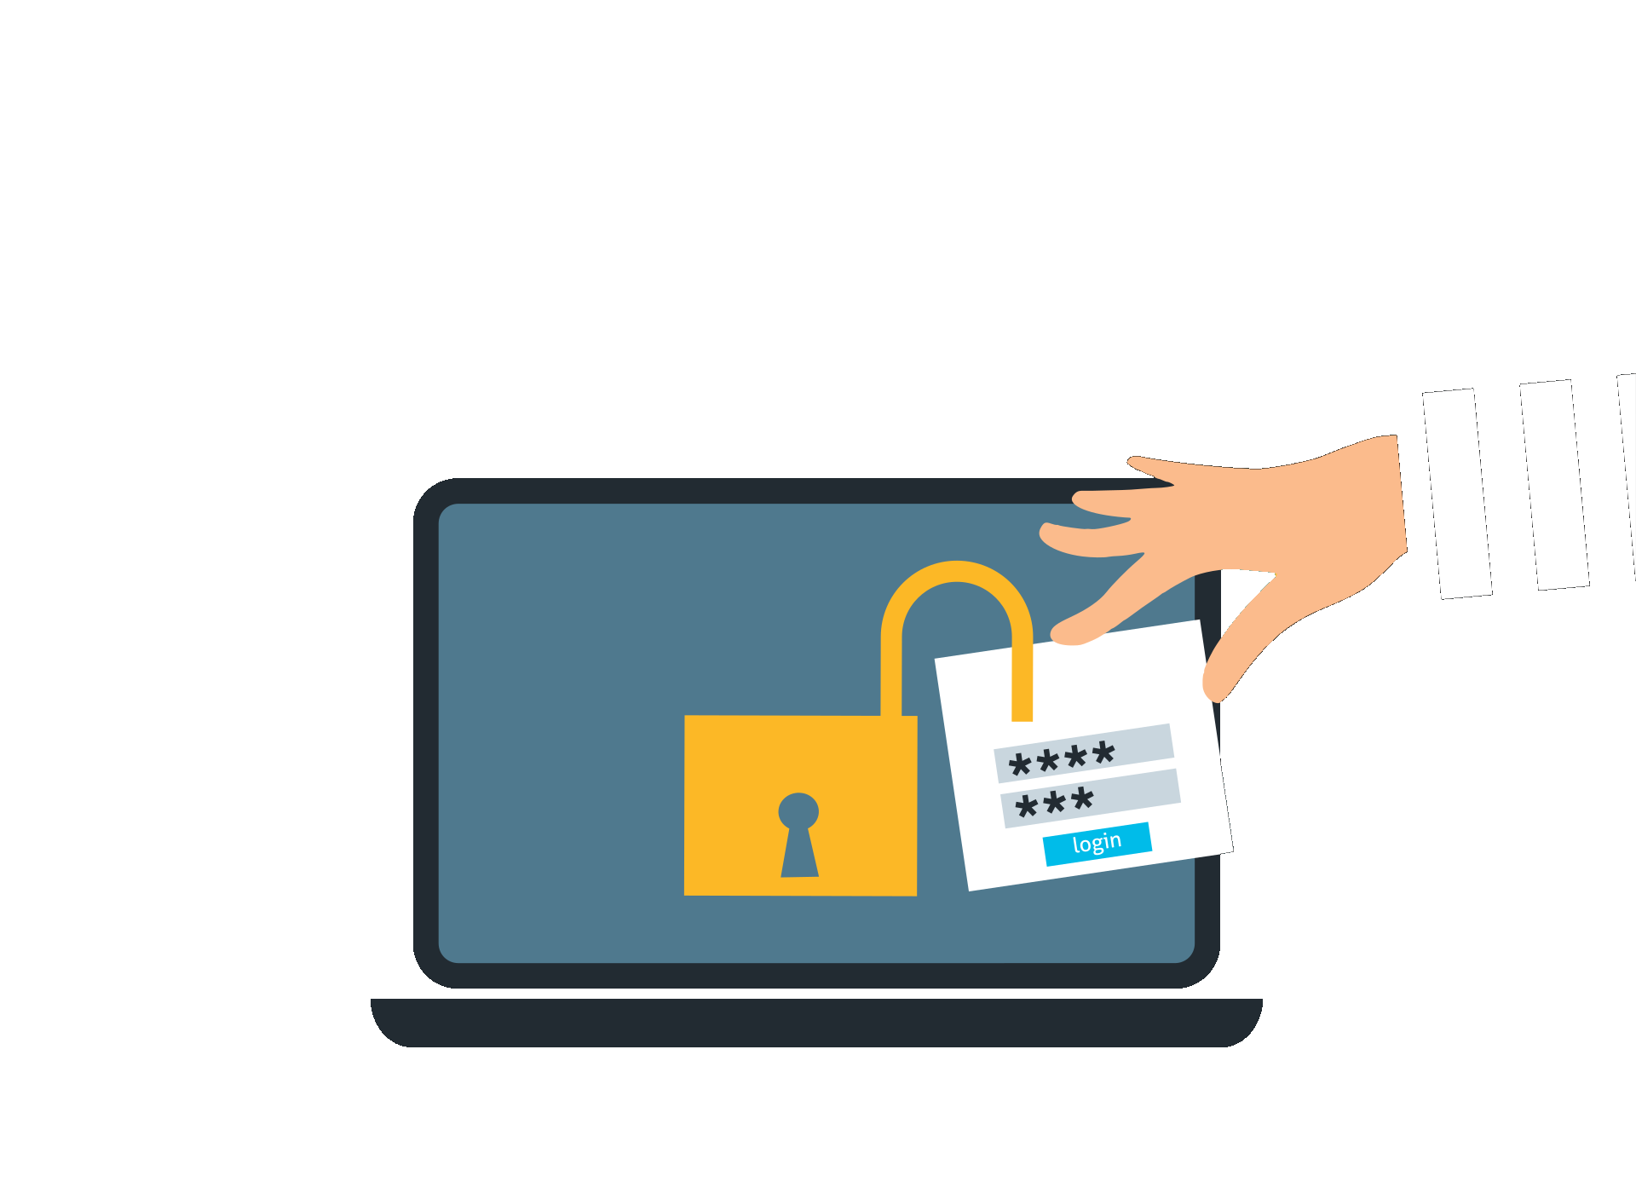
Overview
Breach Totals

Slide 8
$24,724,122,315
Average Revenue Loss From Data Breaches Since 2010
Notes:
Big Data can lead to even bigger revenue losses if you or your employer is not educated and prepared.

Slide 9
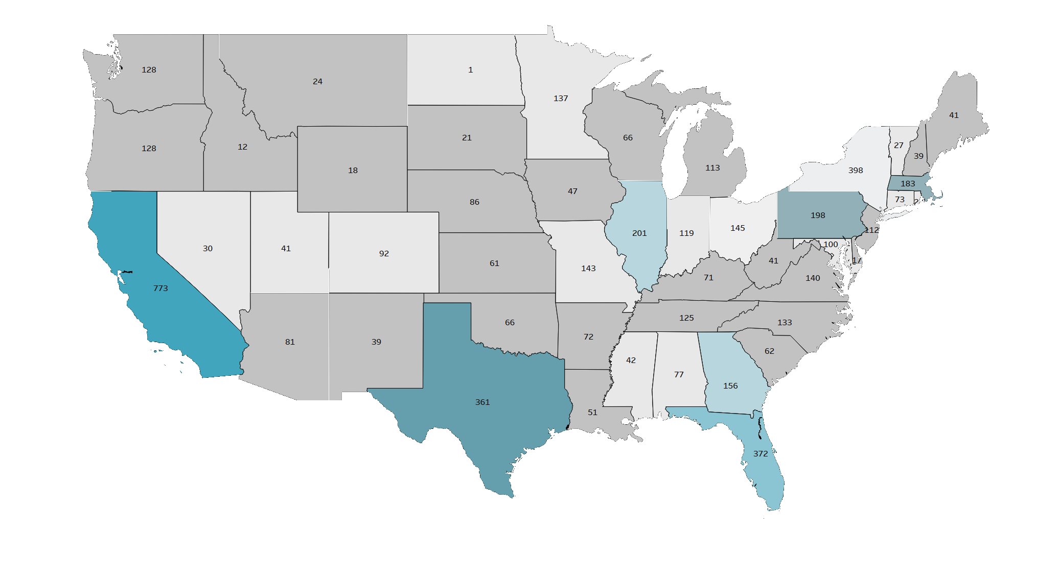

Total Breaches by State
Notes:
Interesting breakdown showing breach totals by state since 2010.
Most of these probably correlate with state population, and industry.
Not our main topic, but an interesting overview non the less.
HALF WAY

Slide 10
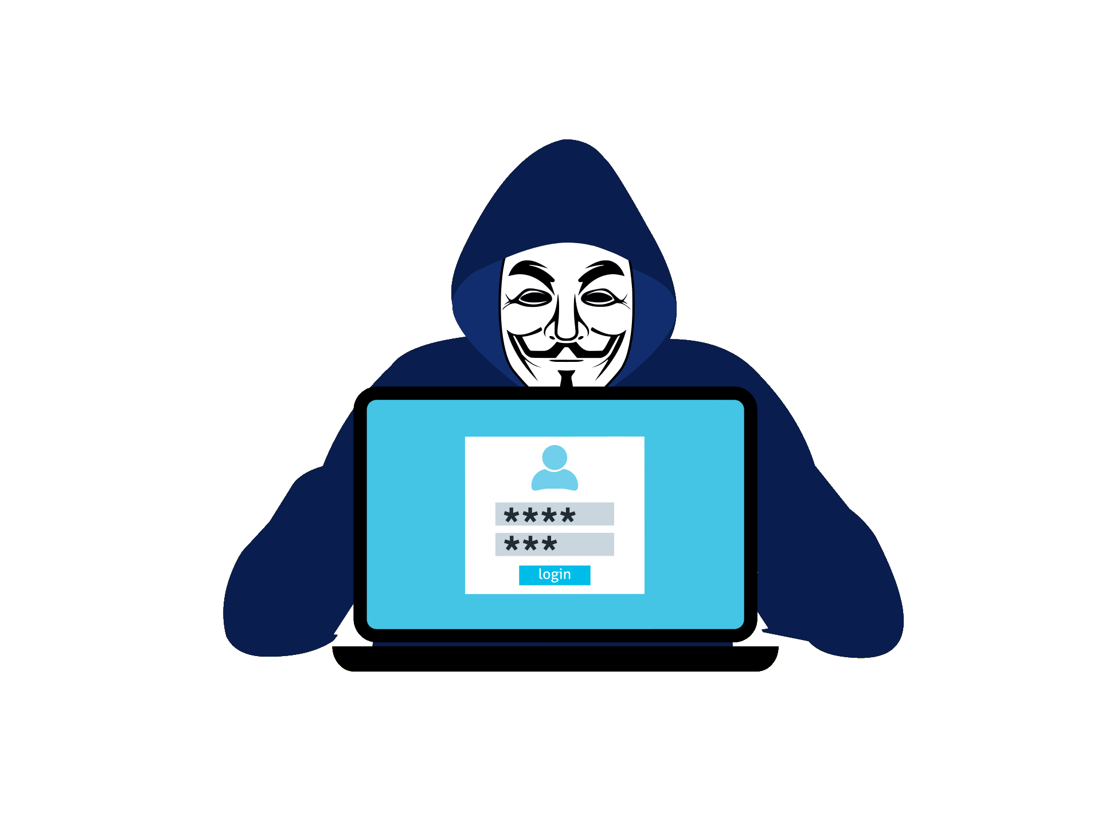
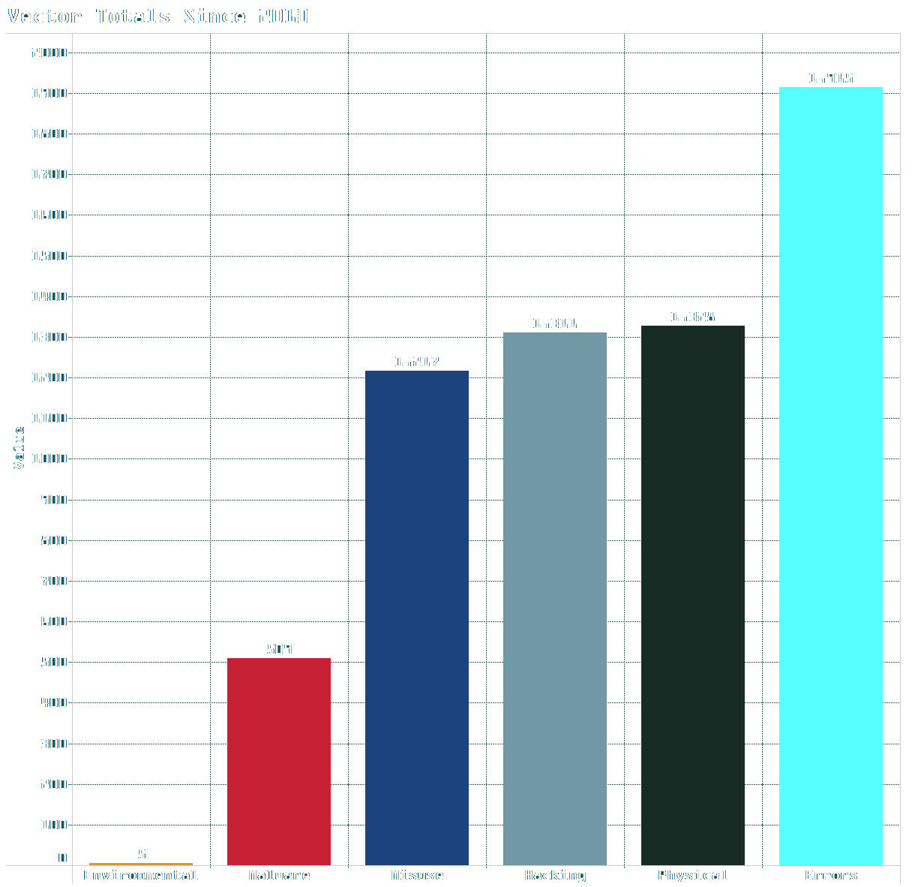
Errors were the most common vector between 2010 and 2022.
Error vectors consist of misdelivery, malfunction, improper disposal, and publishing errors.
Employee mishandling of data can lead to large revenue loss, even when there was no malicious intent.
49% of all actors were internal within the scope of the analysis.
Notes:
Show casing errors as largest contributing vector to data breaches

Slide 11
Analysis
Becoming Aware

Slide 12
“With great power comes great responsibility.” – Uncle Ben
Notes:
An old adage that is most commonly attributed to Uncle Ben from Spideman.
This holds true in the world of data.

Slide 13

Objectives
Increase employee data security awareness to reduce revenue loss due to data breaches.
Show how data breaches can be catastrophic to businesses.
Increased spending on cyber security will result in fewer incidents, preventing costly

Slide 14

Awareness
Data Governance – Minimize Risks By Following Procedures.
Data Privacy – Handle PPI Properly and Follow Legal Compliance. (GDPR/CCPA)
Protection and Security – Be Aware of Potential Risks. Cyber Security is a Team Sport.
Notes:
General Data Protection Regulation
California Consumer Privacy Act

Slide 15
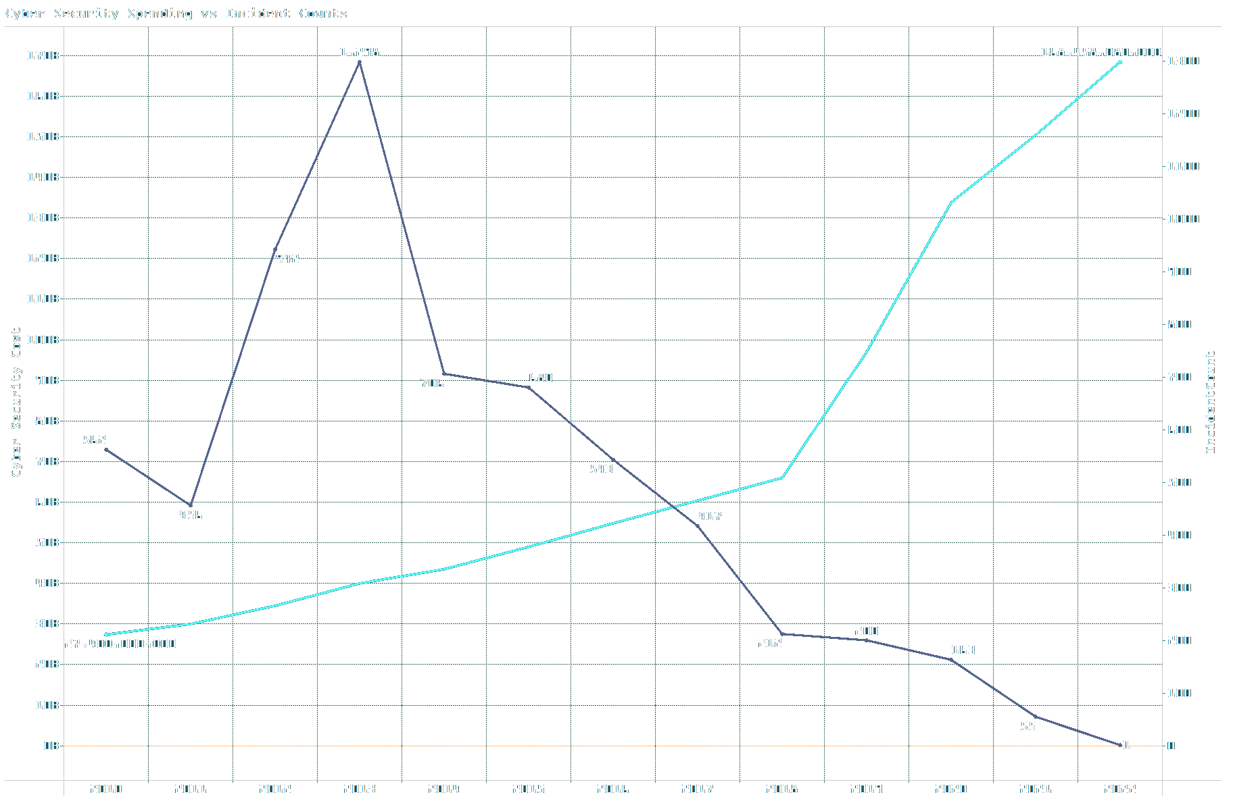

Increased spending on cyber security is correlated with fewer breaches.
Cyber security spending is estimated to continue growing at 12% over 2022.
Notes:
With Cyber Security becoming a necessity, costs rise, but the amount of incidents lower.
More Cyber Security equates to fewer incidents.

Slide 16
$73,002,755,00
Revenue lost due to data breaches involving non-malicious human error since 2010

Slide 17
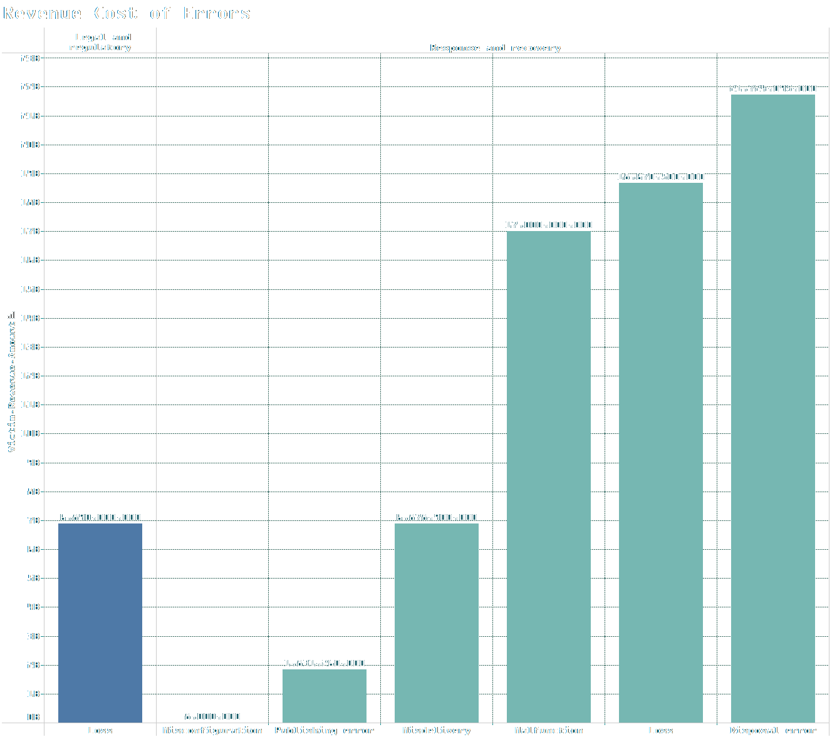

One of the most common vectors for a data breach involves human error, totaling 2,674 incidents, or 28% of the breaches caused since 2010.
Of those incidents, 93% were due to carelessness on the employee’s part.

Slide 18
The Conclusion

Slide 19
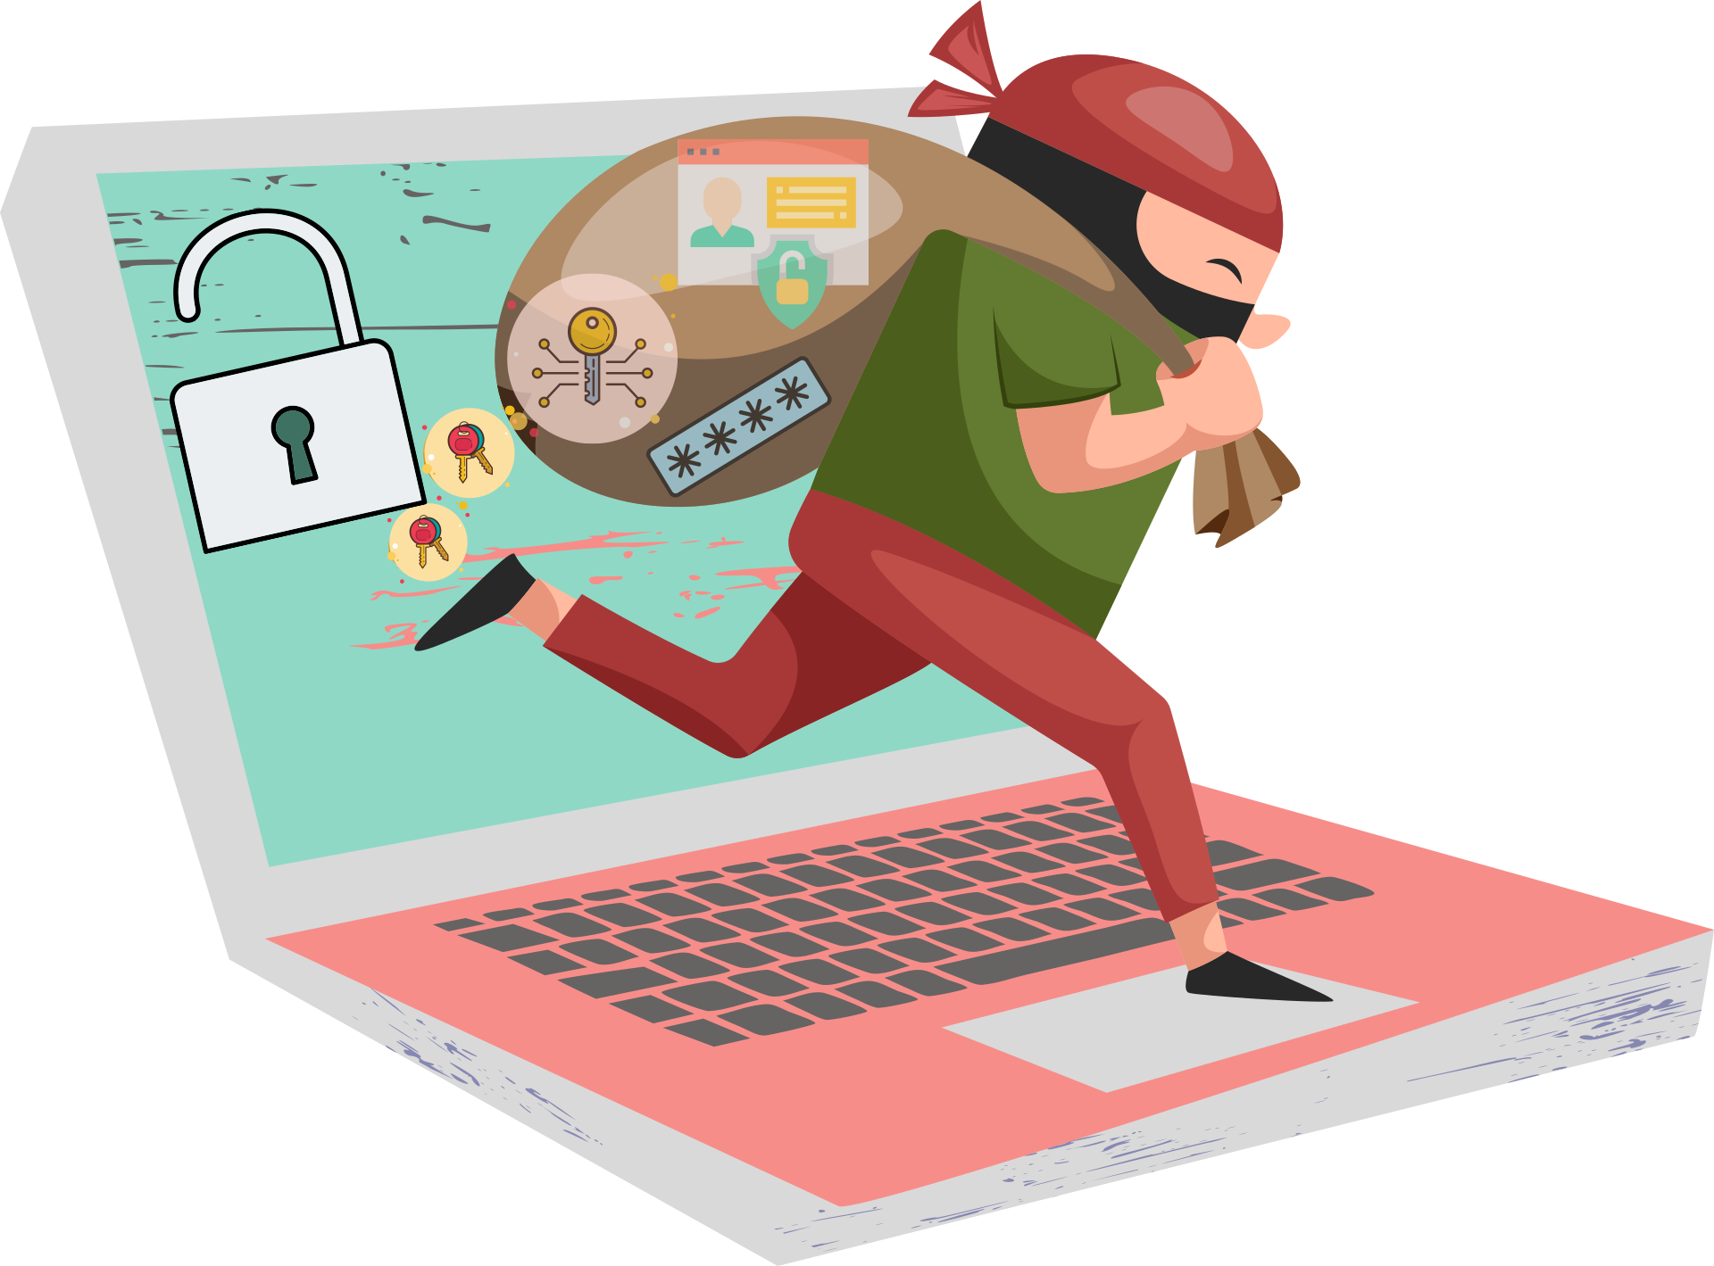
What we know
Major losses are not always incited by malicious sources.
Nearly half of the actors were internal.
Employees have a major role to play in securing data.
Increased funding for cyber security will reduce incidents.

Slide 20




Thank you!
Tommy Ramey
Notes:
Thanks to everyone I have interacted with during these 10 weeks.
I appreciate all of the opportunities I have had to troubleshoot, learn, and reinforce my learning through sharing.
Thanks to all of the instructors.
I see bright futures here for everyone.
This is the end of the beginning.
I hope that everyone continues to expand their knowledge and education.
Please do not hesitate to contact me if you need any help or have questions that you think I would be able to answer; or if you just need someone to struggle alongside you until we figure it out together.
Thanks again, and I hope everyone has a great rest of their day.

